Slide 1

MoCodes Introduction

Slide 2

Searching Algorithm
Coding in Python.

Slide 3
Linear Search
A simple approach is to do linear search, i.e
Start from the leftmost element of arr[ ] and one by one compare x with each element of arr[ ].
If x matches with an element, return the index.
If x doesn’t match with any of elements, return -1.

Slide 4
Linear Search
Element that needed to be Searched = 12
list
2 | 4 | 8 | 12 | 14 | 17 | 19
array
a[0] | a[1] | a[2] | a[3] | a[4] | a[n-1]

Slide 5
Linear Search
Drawbacks :
1.Elements in array need to be sorted.
2.Its not Efficient as other search algorithm .(Binary,Jump)
3.As Elements increases Search is also Complex.
Time complexity O(n)

Slide 6
Binary Search
Search a sorted array by repeatedly dividing the search interval in half.
Begin with an interval covering the whole array.
If the value of the search key is less than the item in the middle of the interval, narrow the interval to the lower half.
Otherwise narrow it to the upper half.

Slide 7
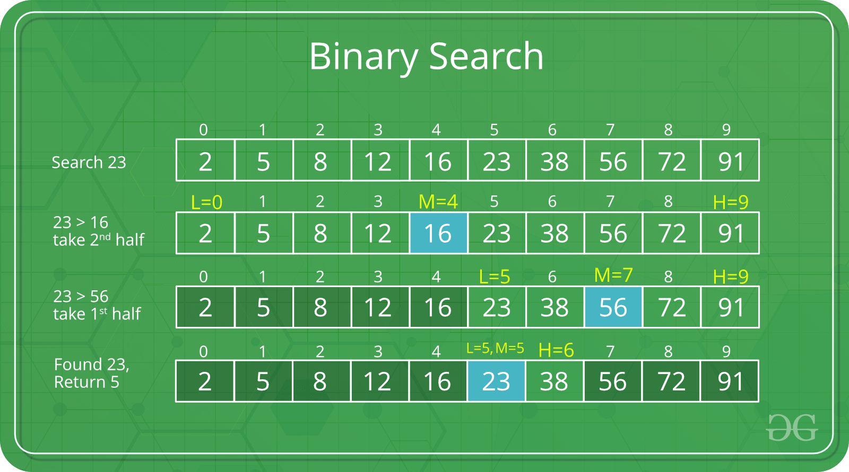

Slide 8
Binary Search
We basically ignore half of the elements just after one comparison.
Compare x with the middle element.
If x matches with middle element, we return the mid index.
Else If x is greater than the mid element, then x can only lie in right half subarray after the mid element. So we recur for right half.
Else (x is smaller) recur for the left half.

Slide 9
Binary Search
Drawbacks:
Recursive nature takes more time while compared to other algorithms.
If the number is Repeated in array then it only returns the index of the middle most element which comes first.
Mostly Binary Search is Error Prone .
It always rely on “ // ” operator.
Time Complexity Theta (LogN).

Slide 10
Jump Search
It is partially like binary search and linear Search.
It jumps a certain number of index using the formula sqrt(len(n)) ,where n is number of index in array.
For example, suppose we have an array arr[] of size n and block (to be jumped) size m. Then we search at the indexes arr[0], arr[m], arr[2m]…..arr[km] and so on.
Once we find the interval (arr[km] < x < arr[(k+1)m]), we perform a linear search operation from the index km to find the element x.

Slide 11
Jump Search
Element need to be Searched = 8 Jump = Sqrt(16)== 4
Step 1 :Jump from a[0] to a[3]. // Element not found. I.e Greater than this term.
Step 2 : Jump from a[3] to a[7].//Element not found less than this term.
Step 3.Since element at a[7] is greater than 8 it jumps back to a[3] and performs Linear Search.
1 | 3 | 5 | 6 | 8 | 11 | 12 | 16 | 18 | 19 | 20 | 23 | 24 | 27 | 28 | 30
a[0] | a[1] | a[2] | a[3] | a[4] | a[5] | a[6] | a[7] | a[8] | a[9] | a[10] | a[11] | a[12] | a[13] | a[14] | a[15]

Slide 12
Jump Search
Drawbacks :
Works only on sorted arrays.
It is Slower Than Binary Search Algorithm.
Time Complexity is O(root n).

